Slide 1
Score-Based Generative Modeling Through Stochastic Differential Equations
김지환

Slide 2
Background
SMLD
DDPM
Score SDE
Results

Slide 3
1. Background

Slide 4
1. Background
Score SDE
Score-based generative modeling through stochastic differential equations
노이즈로부터 데이터를 생성하는 것이 generative modeling.
Stochastic Differential Equation (SDE)을 사용해 복잡한 data distribution에서 known prior distribution 변환.
그에 상응하는 reverse-time SDE를 통해 prior distribution에서 data distribution으로 돌릴수 있다.
Reverse-time SDE는 오직 Perturbed data distribution의 time-dependent gradient field (score)에 의존한다.
우리는 neural network를 통해 score를 estimate할 수 있고 numerical SDE solver를 이용해 sampling을 할 수 있음.
Contribution
Discretized reverse-time SDE의 진화(evolution) 과정에서 발생하는 오류를 Predictor-Corrector framework를 사용해 보정.
해당 SDE와 동일한 분포에서 샘플링하지만 정확한 likelihood 계산과 샘플링 효율을 개선한 Ordinary Differential Equation(ODE)을 소개.

Slide 5
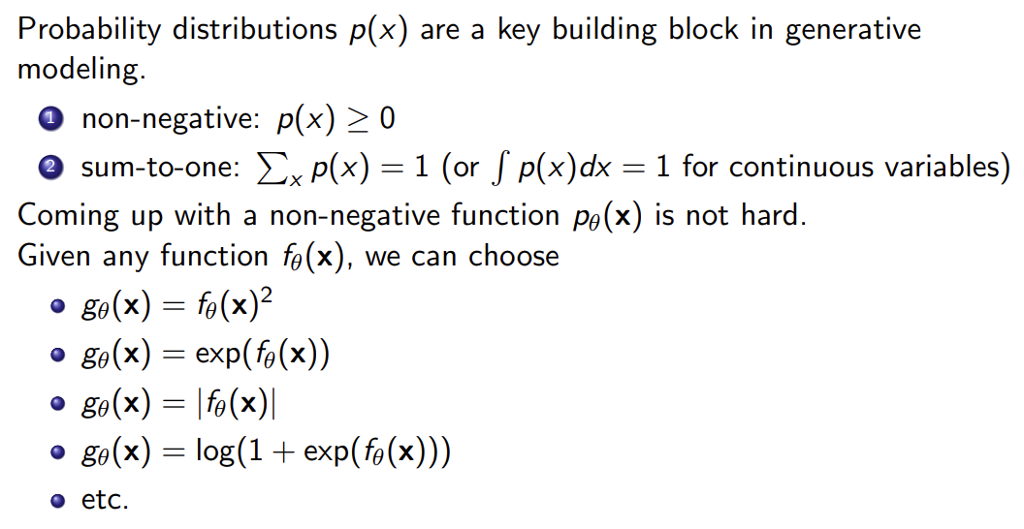
1. Background
Score SDE
Parameterizing probablity distributions
https://deepgenerativemodels.github.io/assets/slides/cs236_lecture11.pdf
Notes:
확률분포의 조건
0이상, 합이1
0 이상인 것은 아무렇게나 잘 정할수 있다.

Slide 6
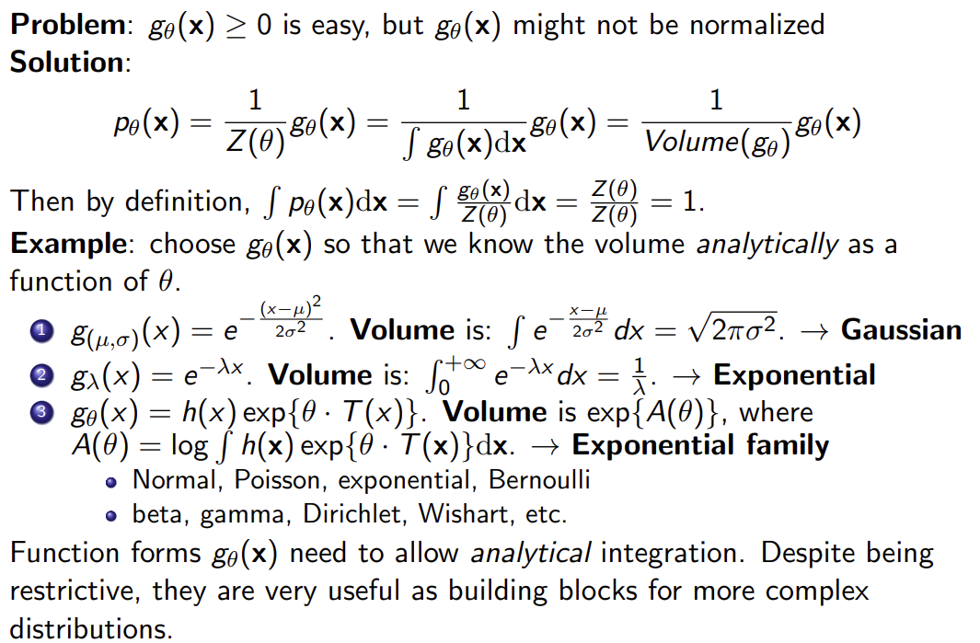
1. Background
Score SDE
Parameterizing probablity distributions
https://deepgenerativemodels.github.io/assets/slides/cs236_lecture11.pdf
Notes:
그렇다면 나머지 1로 만드는 것이 필요한데 분모에 분자함수의 합(적분, volume)을 더해주는 꼴로 만들수 있다.
gaussian, exponential 분포등이 이런식으로 구성되어있다.

Slide 7
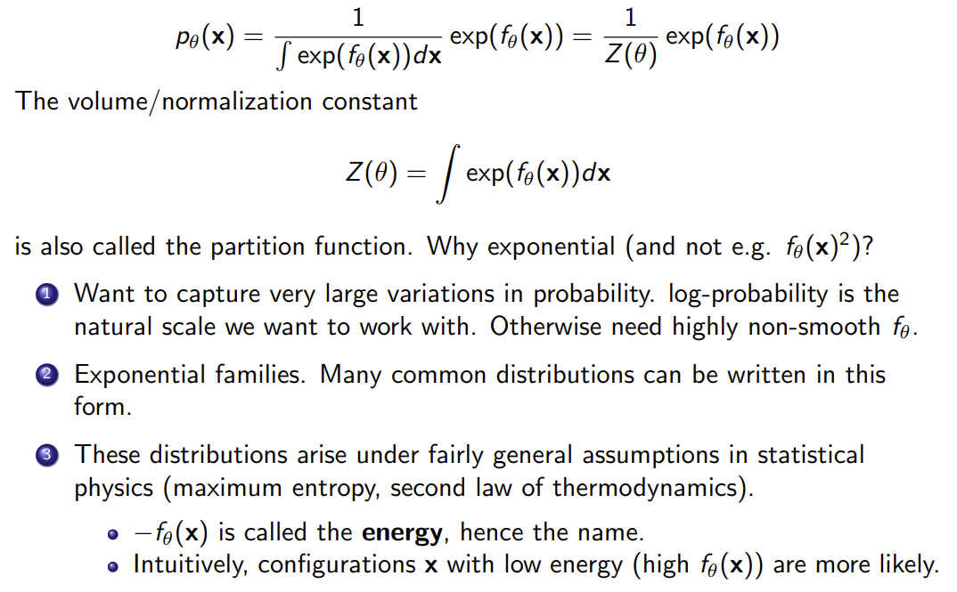
1. Background
Score SDE
Parameterizing probablity distributions
https://deepgenerativemodels.github.io/assets/slides/cs236_lecture11.pdf
Notes:
최종적으로 exponential(f(x)) 꼴로 만들 수 있는데, exponential을 사용한 이유는.
다음과 같이 3가지 이유가 있다.

Slide 8
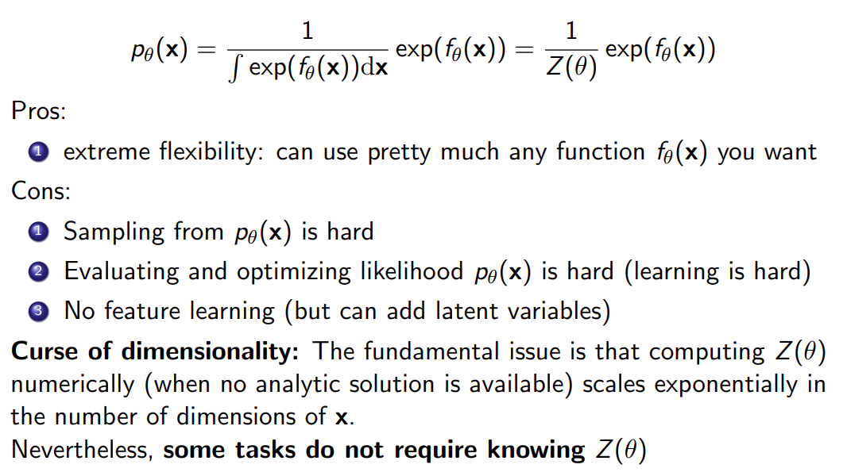
1. Background
Score SDE
Parameterizing probablity distributions
https://deepgenerativemodels.github.io/assets/slides/cs236_lecture11.pdf

Slide 9
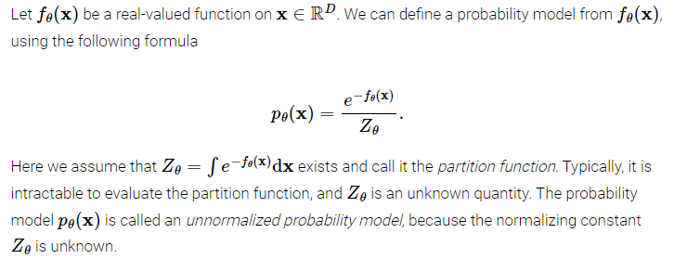
1. Background
Score SDE
Score matching with Langevin Dynamics (SMLD)
Score matching
Unnormalized probability models
https://yang-song.net/blog/2021/score/

Slide 10
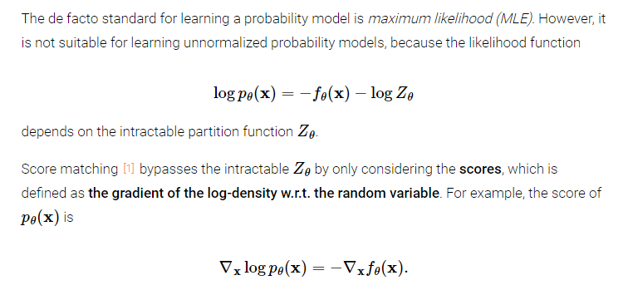
1. Background
Score SDE
Score matching with Langevin Dynamics (SMLD)
Score matching
https://yang-song.net/blog/2021/score/

Slide 11
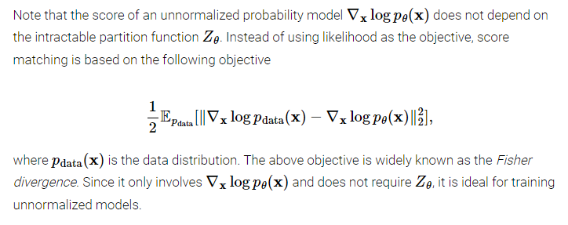
1. Background
Score SDE
Score matching with Langevin Dynamics (SMLD)
Score matching
https://yang-song.net/blog/2021/score/

Slide 12
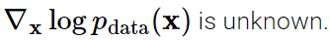
1. Background
Score SDE
Score matching with Langevin Dynamics (SMLD)
Score matching
https://yang-song.net/blog/2021/score/

Slide 13
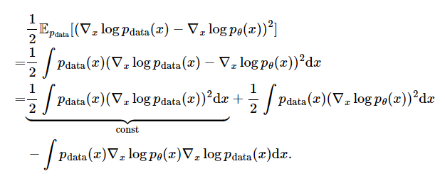
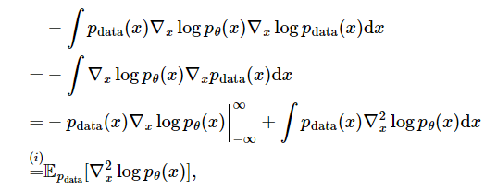
1. Background
Score SDE
Score matching with Langevin Dynamics (SMLD)
Score matching
https://yang-song.net/blog/2021/score/

Slide 14
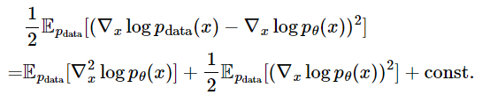
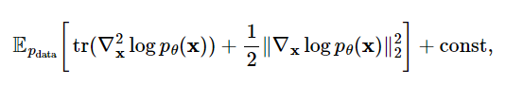
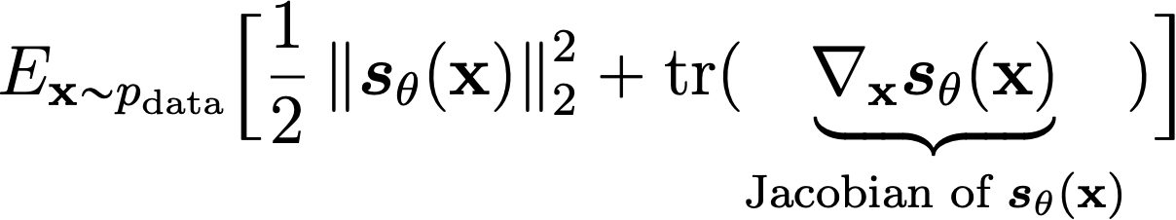
1. Background
Score SDE
Score matching with Langevin Dynamics (SMLD)
Score matching
https://yang-song.net/blog/2021/score/
Notes:
자코비안 Matrix가 data dimension이 커지면 계산이 어렵다는 단점.

Slide 15
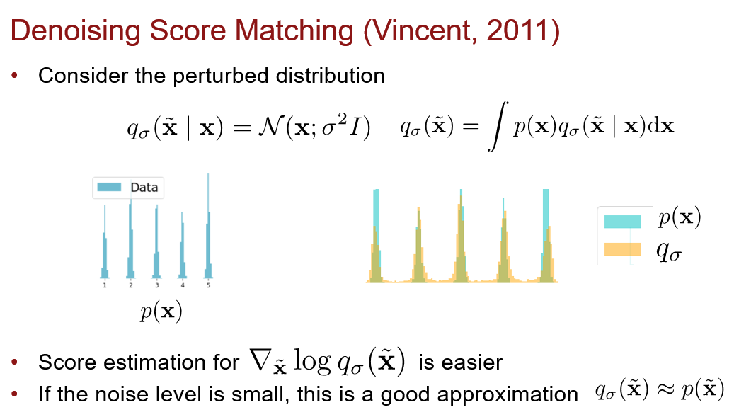
1. Background
Score SDE
Score matching with Langevin Dynamics (SMLD)
Denoising score matching
https://deepgenerativemodels.github.io/syllabus.html
Notes:
Variational inference

Slide 16
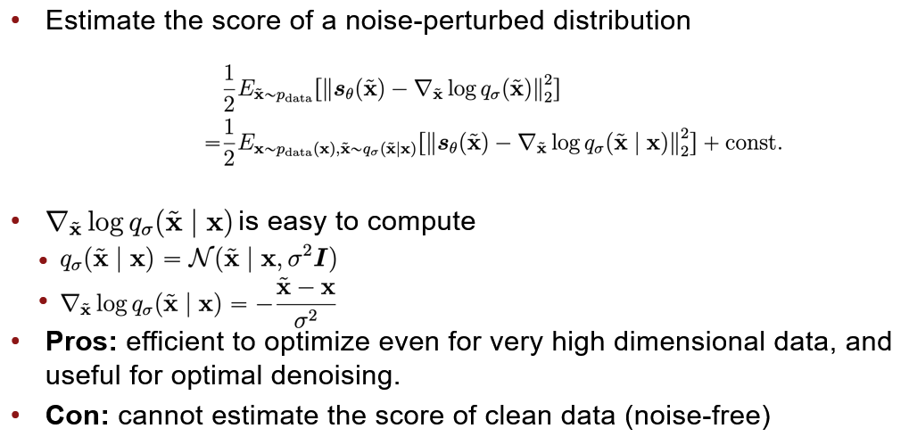
1. Background
Score SDE
Score matching with Langevin Dynamics (SMLD)
Denoising score matching
https://deepgenerativemodels.github.io/syllabus.html

Slide 17
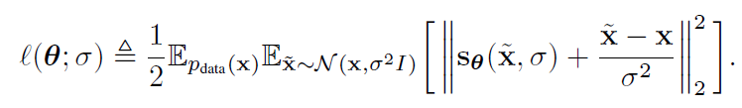
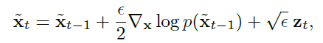
1. Background
Score SDE
Score matching with Langevin Dynamics (SMLD)
Objective function
Langevin dynamics sampling

Slide 18
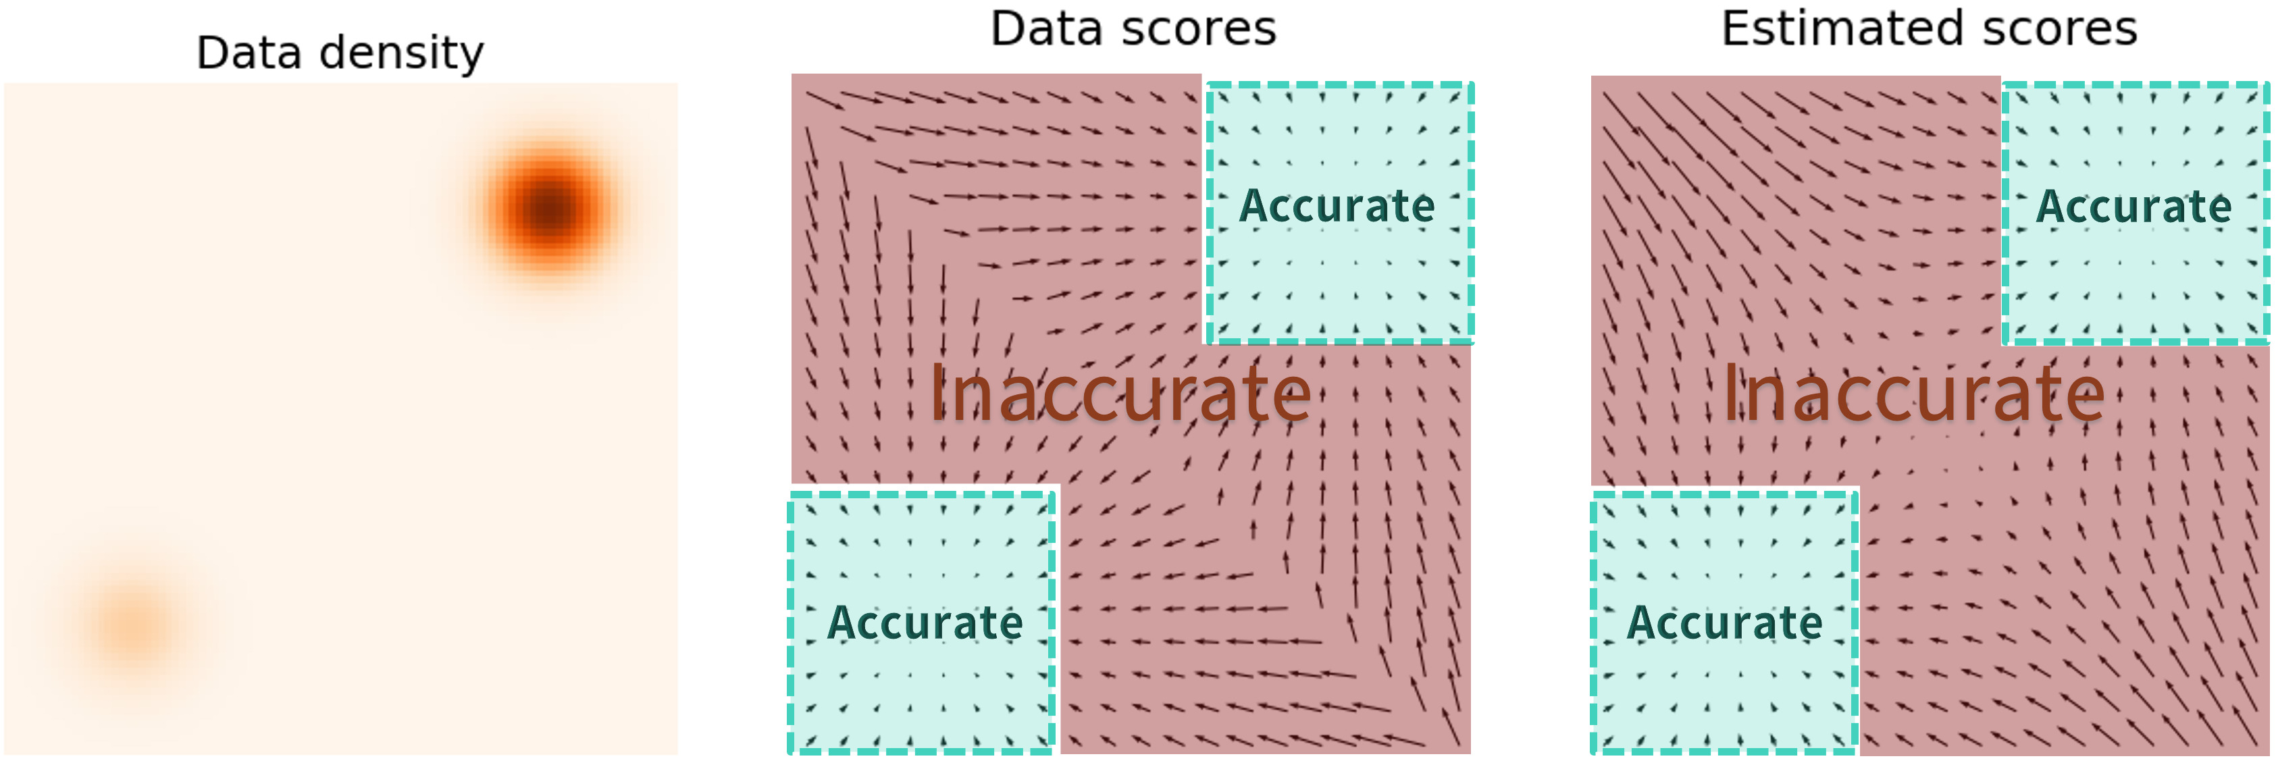
1. Background
Score SDE
Score matching with Langevin Dynamics (SMLD)
Data의 density 가 낮은 곳에서의 Score estimation이 정확하지 않음.
https://yang-song.net/blog/2021/score/

Slide 19
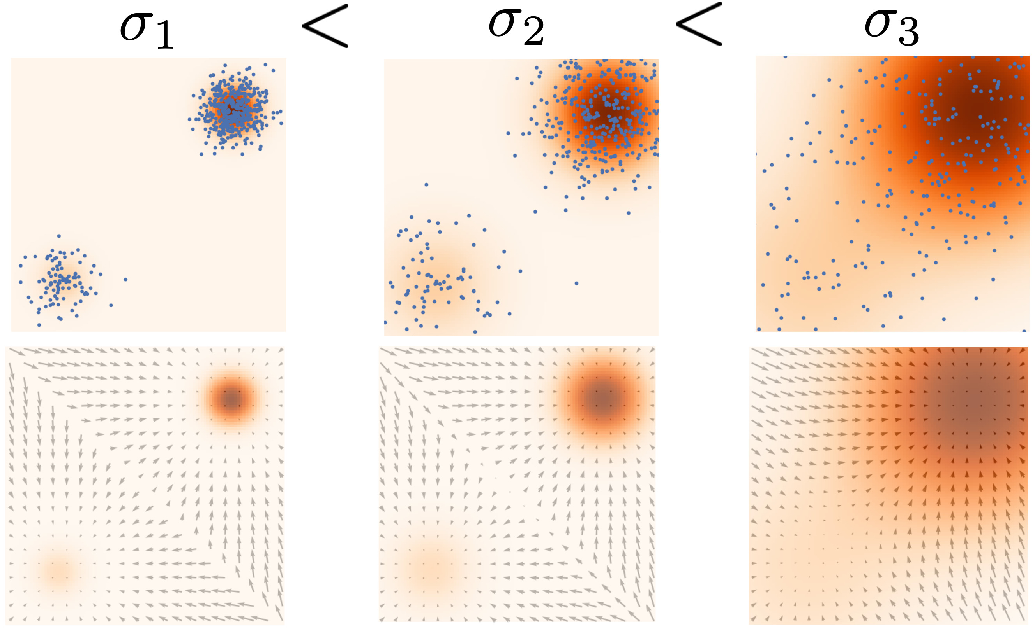
1. Background
Score SDE
Score matching with Langevin Dynamics (SMLD)
Noise perturbation을 다양하게 주고 해당 noise에서 score를 잘 맞추도록 모델을 학습하자
Sampling 할때 sigma를 점점 줄여가며 정확하게 sampling
https://yang-song.net/blog/2021/score/

Slide 20
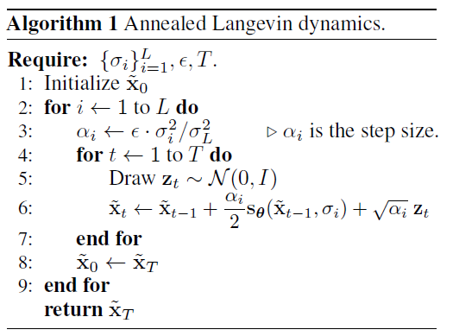
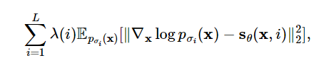
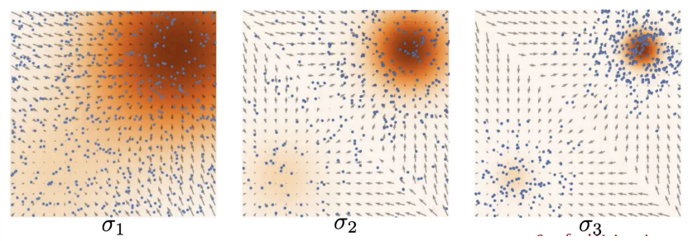
1. Background
Score SDE
Score matching with Langevin Dynamics (SMLD)
최종 Objective function
Annealed Langevin dynamics.
https://yang-song.net/blog/2021/score/

Slide 21
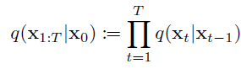
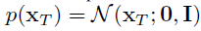
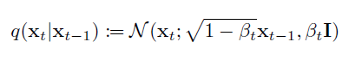
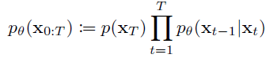
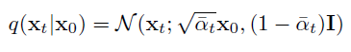
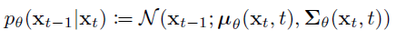
1. Background
Score SDE
Denoising Diffusion Probablistic Models (DDPM)
Forward process: q(x_{t}|x_{t-1}), 이미지에 노이즈를 추가해주는 것
Reverse Process: p(x_{t-1}|x_{t}), 노이즈를 제거하는 것
Markov Chain 가정 & Prior 분포를 Normal distribution 설정.

Slide 22
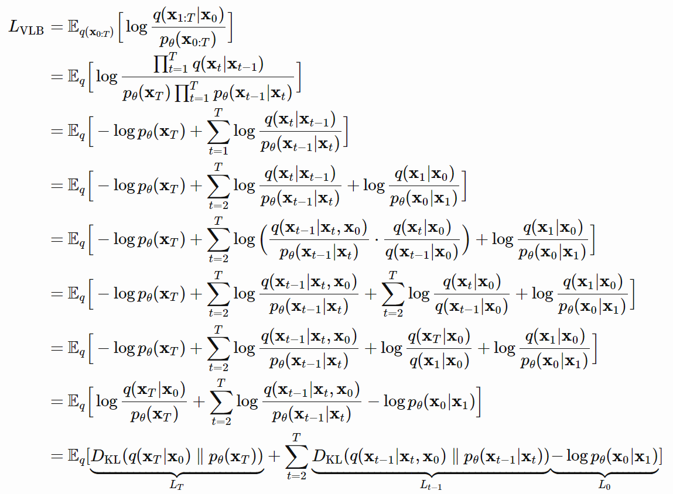
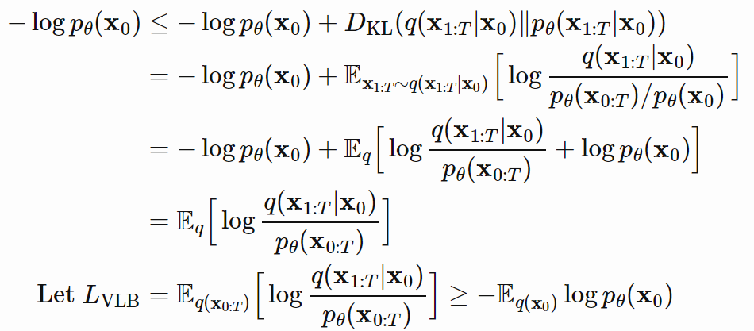
1. Background
Score SDE
Denoising Diffusion Probablistic Models (DDPM)
Reverse p(x_{t-1}|x_{t}) 를 어떻게 학습시킬 것인가: L_{vlb} 최소화 하는 식을 통해 모델링
q(x_{t-1}|x_{t},x₀)은 수식으로 구할수 있으니 딥러닝 모델을 이용해 p(x_{t-1}|x_{t})를 만들고 둘의 mean값을 최소화 (DDPM에서 variance는 고정, 이후 variance까지 학습하는 모델도 존재)
https://lilianweng.github.io/posts/2021-07-11-diffusion-models/

Slide 23
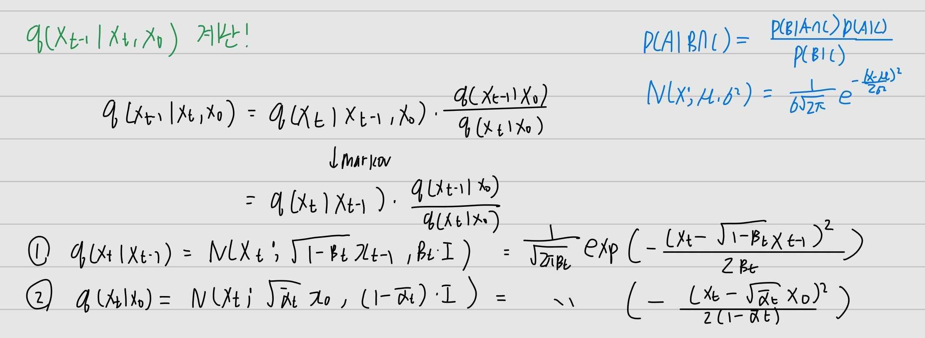
1. Background
Score SDE
Denoising Diffusion Probablistic Models (DDPM)
q(x_{t-1}|x_{t},x₀)는 베이즈정리와 Normal distribution 분포를 정리해서 계산됨.

Slide 24
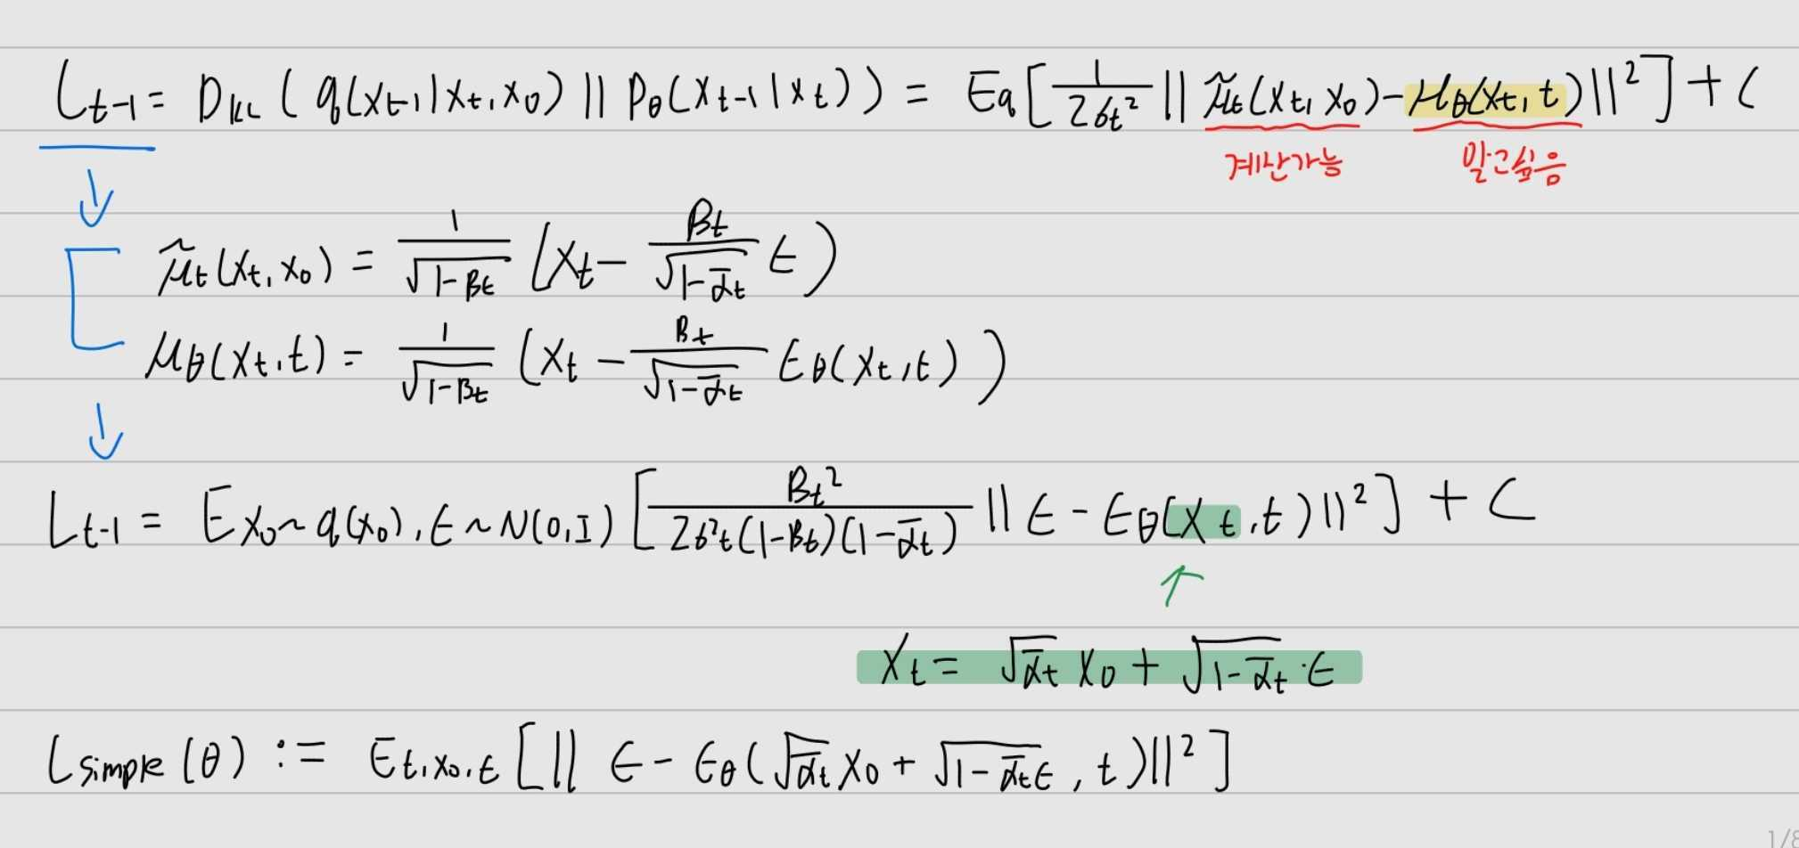
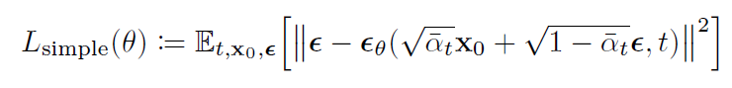
1. Background
Score SDE
Denoising Diffusion Probablistic Models (DDPM)
Reparameterization trick을 통해 X₀, X_{t} 표현 가능
최종 DDPM Loss function

Slide 25
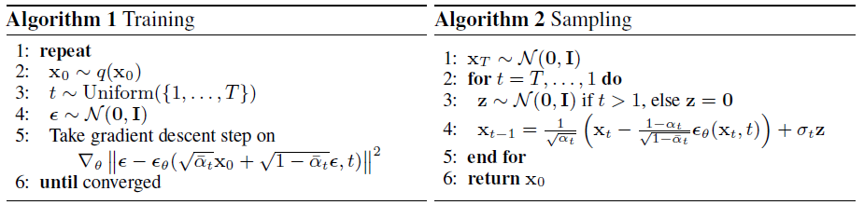
1. Background
Score SDE
Denoising Diffusion Probablistic Models (DDPM)
Training & Sampling
Denoising score matching training
Iteratively Sample from decoders
(Annealead Langevin Dynamics)

Slide 26
2. Score SDE

Slide 27
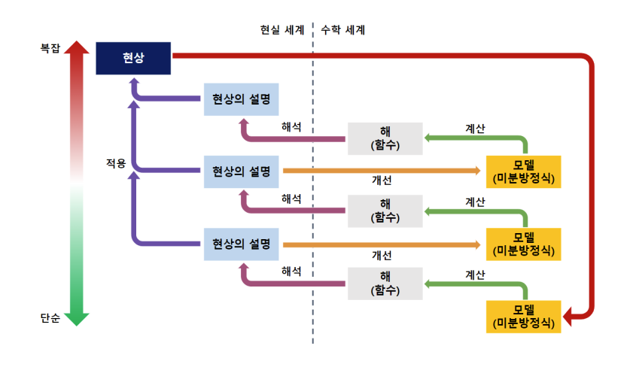
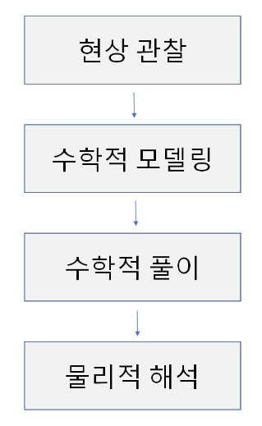
2. Score SDE
Score SDE
Score-based generative modeling through stochastic differential equations
미분방정식?
엔지니어가 어떠한 현상을 해석하는 단계
https://brunch.co.kr/@quantdaddy/177

Slide 28
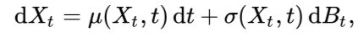
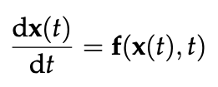
2. Score SDE
Score SDE
Score-based generative modeling through stochastic differential equations
Stochastic Differential Equation - 확률적 모델, 시간에 따른 시스템의 상태 변화를 확률적으로 설명.
Ordinary Differential Equation - 결정론적 모델, 초기조건과 방정식이 주어지면 유일한 해를 가짐.

Slide 29
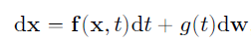
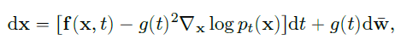
2. Score SDE
Score SDE
Score-based generative modeling through stochastic differential equations
데이터 distribution에서 특정 prior distribution으로 보내는 diffusion process { x(t) } 를 Ito SDE로 모델링이 가능하다.
f: drift coefficient of x(t)
g: diffusion coefficient of x(t)
w: standard Wiener process (Brownian motion)
그렇다면 prior distribution에서 데이터 distribution으로 보내는 reverse diffusion process 또한 존재 할 것이다. (Brian D O Anderson. Reverse-time diffusion equation models. Stochastic Process)
w: standard Wiener process when time flows backwards from T to 0
dt: infitesimal negative timestep
: Score matching을 통해 알아내자

Slide 30
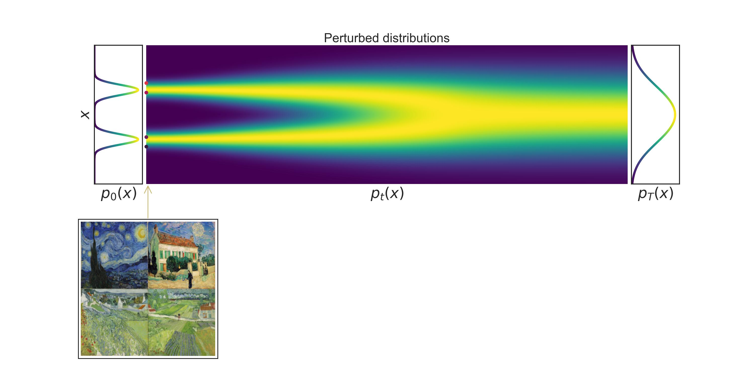
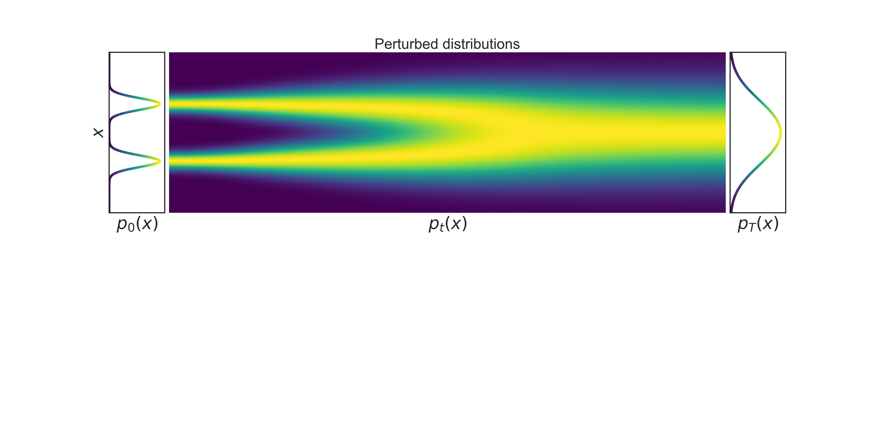
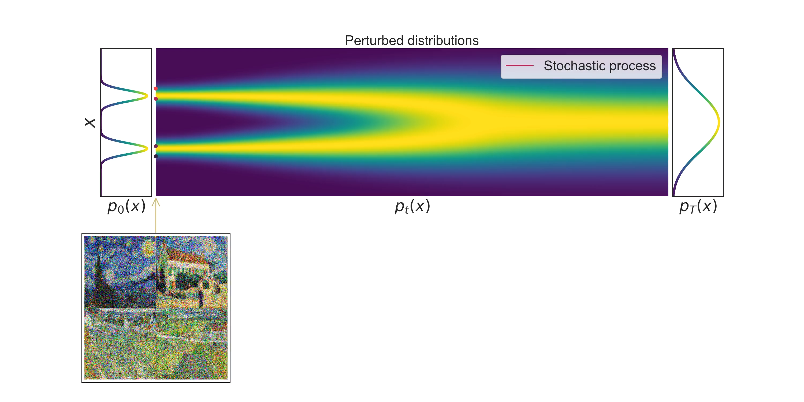
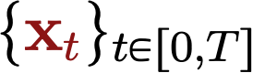
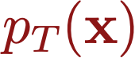
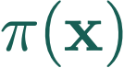
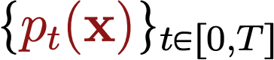
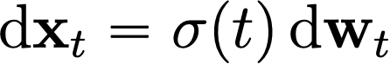
Perturbing data with stochastic processes
Stochastic process
Stochastic differential equation (SDE)
Deterministic drift
Infinitesimal noise
Probability densities
WLOG: Toy SDE

Slide 31
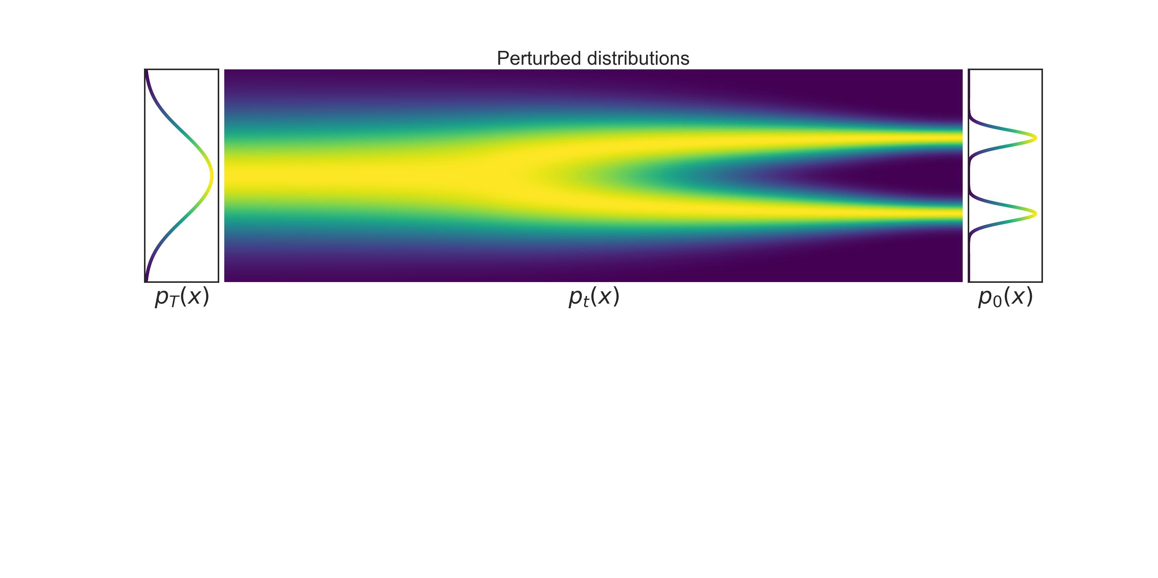
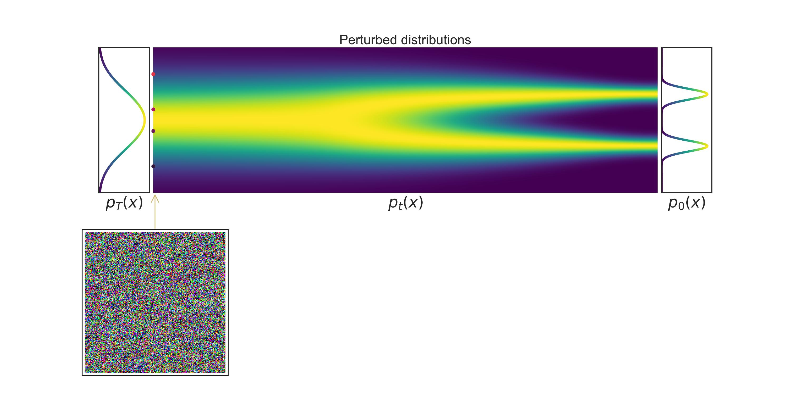

Generation via reverse stochastic processes
Forward SDE (t: 0→T)
Infinitesimal noise in the reverse time direction
Reverse SDE (t: T→0)
Score function!

Slide 32


2. Score SDE
Score SDE
Score-based generative modeling through stochastic differential equations
: Score matching을 통해 알아내자
Time-dependent score-base model s(x, t)를 훈련
Time-dependent score-based model
Training
Reverse-time SDE
Euler-Maruyama (analgous to Euler for ODEs)
Notes:
오일러-마루야마 방법: SDE를 근사하기 위한 이산화된 형태.

Slide 33





2. Score SDE
Score SDE
Score-based generative modeling through stochastic differential equations
이 Framework 안에서 이전에 보았던 SMLD와 DDPM을 다시 적어보면 다음과 같이 표현된다
SMLD
DDPM
T가 커질수록 variance exploding: VE SDE
T가 커져도 variance 가 fix되어있음: VP SDE
더 좋은 SDE 만들었다: sub-VP SDE
Notes:
SMLD와 DDPM의 Markov chain을 이용한 noise perturbation 방식은 다음과 같은 수식이고,
이것은 밑의 forward sde를 푸는것과 동일하다.
그렇다면 forward sde에 대응하는 reverse sde의 수식에 모든것을 집어넣으면 된다.

Slide 34


2. Score SDE
Score SDE
Score-based generative modeling through stochastic differential equations
SMLD

Slide 35


2. Score SDE
Score SDE
Score-based generative modeling through stochastic differential equations
DDPM

Slide 36

2. Score SDE
Score SDE
Score-based generative modeling through stochastic differential equations
Predictor-Corrector samplers
우리는 score를 추정하는 모델을 학습했기 때문에 이를 이용해 더 정확한 sampling을 할 수 있다
Langevin MCMC, HMC
Correcting the solution of numerical SDE solver
SMLD와 DDPM의 Sampling과정을 다음과 같이 일반화가 가능하다
corrector
predictor
https://deepgenerativemodels.github.io/syllabus.html

Slide 37

2. Score SDE
Score SDE
Score-based generative modeling through stochastic differential equations
Probability Flow and connection to neural ODEs
SDE에 상응하는 ODE가 존재하고 이를 Probability flow ODE라고 한다 (논문 증명)
Fast Sampling
Exact likelihood computation, Uniquely identifiable encoding, Manipulating latent representations

Slide 38

2. Score SDE
Score SDE
Code
https://github.com/yang-song/score_sde_pytorch

Slide 39




2. Score SDE
Score SDE
Code
VE-SDE
https://github.com/yang-song/score_sde_pytorch/blob/main/sde_lib.py

Slide 40



2. Score SDE
Score SDE
Code
VE-SDE
https://github.com/yang-song/score_sde_pytorch/blob/main/sde_lib.py

Slide 41



2. Score SDE
Score SDE
Code
VP-SDE
https://github.com/yang-song/score_sde_pytorch/blob/main/sde_lib.py

Slide 42



2. Score SDE
Score SDE
Code
VP-SDE
https://github.com/yang-song/score_sde_pytorch/blob/main/sde_lib.py

Slide 43


2. Score SDE
Score SDE
Code
Reverse SDE
Forward SDE
Reverse SDE
https://github.com/yang-song/score_sde_pytorch/blob/main/sde_lib.py

Slide 44
2. Score SDE
Score SDE
Code
Reverse SDE
Forward SDE
Reverse SDE
https://github.com/yang-song/score_sde_pytorch/blob/main/sde_lib.py

Slide 45


2. Score SDE
Score SDE
Code
Sampling
EulerMaruyama + Langevin

Slide 46



2. Score SDE
Score SDE
Code
Sampling
Blackbox ODE solver

Slide 47
3. Results

Slide 48

3. Results
Score SDE
Discrete-time perturbation kernels and continuous generalizations
Match each other almost exactly

Slide 49

3. Results
Score SDE
Comparing reverse-time SDE solvers on CIFAR-10
Reverse diffusion samplers perform slightly better than ancestral sampling for both SMLD and DDPM models on CIFAR-10

Slide 50

3. Results
Score SDE
Comparing reverse-time SDE solvers on CIFAR-10

Slide 51


3. Results
Score SDE
Controllable generation

Slide 52

3. Results
Score SDE
Probability flow ODE

Slide 53
Thank you

